Slide 1
Figures

Slide 2
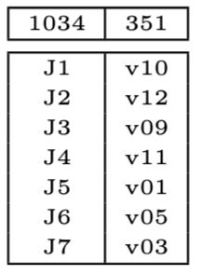
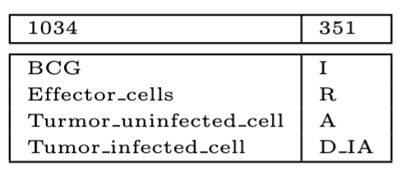
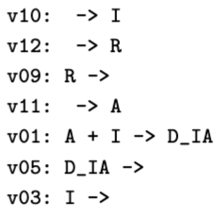
structurally identical subnet (sis) mapping pair
(a) species mapping
(b) reaction mapping
(c) structurally identical inferred subnet

Slide 3
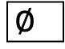
reference CRN
target CRN
Make data for reference constraint evaluation
Make data for target constraint evaluation
1b
1a
reference constraint matrices
target
constraint matrices
2
Find mapping pairs with compatible constraints between reference and target
too many mapping pairs
mapping pairs
$$∅$$
3
Find sis mapping pairs
sis mapping pairs

Slide 4
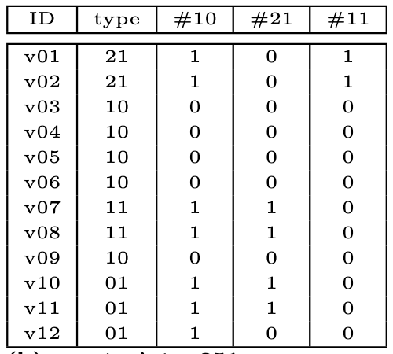
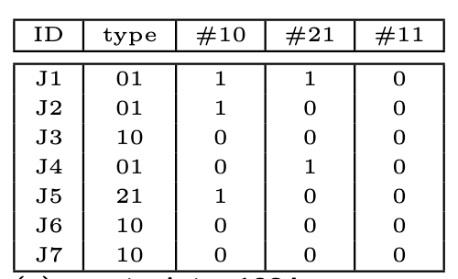
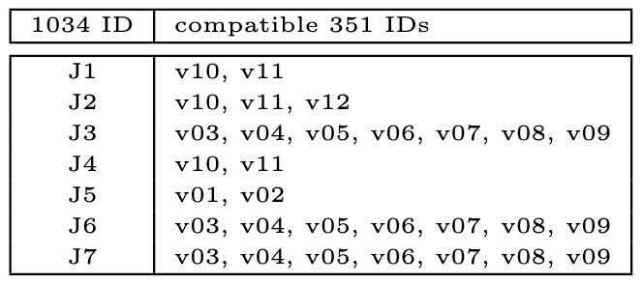
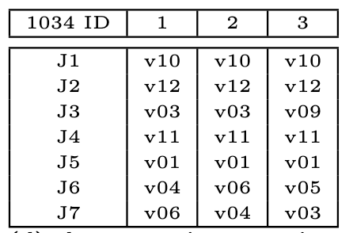
(a) Model 1034: reference
reaction constraint matrix
(b) Model 351: target
reaction constraint matrix
(c) reaction compatibility vector
(d) reaction mappings

Slide 5
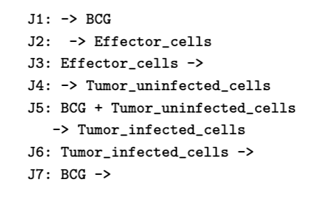
01
J4
C
21
10
J5
D
J6
01
J1
A
10
J7
A: BCG
B: Effector_cells
C: Tumor_uninfected_cells
D: Tumor_infected_cells
01
01
10
21
10
J2
B
J4
10
J3
J5
J6
01
J1
10
J7
01
10
J2
J3

Slide 6
BioModels 1034*
BioModels 351*
1034 induced in 351
J1: -> BCG
J2: -> Effector_cells
J3: Effector_cells ->
J4: -> Tumor_uninfected_cells
J5: BCG + Tumor_uninfected_cells -> Tumor_infected_cells
J6: Tumor_infected_cells ->
J7: BCG ->
v01: A + I -> D_IA
v02: I + I -> D_II
v03: I ->
v04: A ->
v05: D_IA ->
v06: D_II ->
v07: D_IA -> A
v08: D_II -> I
v09: R ->
v10: -> I
v11: -> A
v12: -> R
v10: -> I
v12: -> R
v09: R ->
v11: -> A
v01: A + I -> D_IA
v05: D_IA ->
v03: I ->
Reaction constraint: reaction type
1034 reaction | 1034 reaction type | Compatible 354 reactions
J1 | null-uni | V10, v11, v12
J2 | null-uni | V10, v11, v12
J3 | uni-null | V03, v04, v05, v06, v09
J4 | null-uni | V10, v11, v12
J5 | bi-uni | V01, v02
J6 | uni-null | V03, v04, v05, v06, v09
J7 | uni-null | V03, v04, v05, v06, v09
Species constraint: reactant reactions by type
1034 species | reaction types where 1034 species is a reactant | Compatible 354 species
BCG | bi-uni, uni-null | I, A
Effector.. | null-uni, uni-null | I, A
Tumor_uni.. | null-uni, bi-uni | A, I, R
Tumor_inf.. | uni-null | I, A, D_IA, D_II, R
Assignments of 351 species to 1034 that are consistent with constraints
1034 | 1 | 2 | 3 | 4
BCG | I | I | A | A
Effector.. | A | A | I | I
Tumor_uni.. | R | R | R | R
Tumor_inf.. | D_IA | D_II | D_IA | D_II
*Reaction names have been changed to save space.

Slide 7
Consider connectivity by inferred monopartite graph (via products), # successor
1034 ID | 351 IDs compatible with 1034 ID
J1 | V10, v11
J2 | V10, v11, v12
J3 | V03, v04, v06, v07, v8, v09
J4 | V10, v11
J5 | V01, v02
J6 | V03, v04, v06, v07, v8, v09
J7 | V03, v04, v06, v07, v8, v09
Reaction constraints for 351
Reaction constraints for 1034
ID | type | #u-n succ | #b-u succ | #u-u succ
V01 | b-u | 1 | 0 | 1
v02 | b-u | 1 | 0 | 1
v03 | u-n | 0 | 0 | 0
v04 | u-n | 0 | 0 | 0
v05 | u-n | 0 | 0 | 0
v06 | u-n | 0 | 0 | 0
v07 | u-u | 1 | 1 | 0
v08 | u-u | 1 | 1 | 0
v09 | u-n | 0 | 0 | 0
v10 | n-u | 1 | 1 | 0
v11 | n-u | 1 | 1 | 0
v12 | n-u | 1 | 0 | 0
ID | type | #u-n succ | #b-u succ | #u-u succ
J1 | n-u | 1 | 1 | 0
J2 | n-u | 1 | 0 | 0
J3 | u-n | 0 | 0 | 0
J4 | n-u | 0 | 1 | 0
J5 | b-u | 1 | 0 | 0
J6 | u-n | 0 | 0 | 0
J7 | u-n | 0 | 0 | 0
Some reaction assignments
1034 ID | 1 | 2 | 3 | 4 | …
J1 | V10 | V10 | V10 | V10
J2 | v12 | v12 | v12 | v12
J3 | V03 | V03 | V03 | V09
J4 | v11 | v11 | v11 | v11
J5 | V01 | V01 | V01 | V01
J6 | v04 | v06 | v07 | v05
J7 | v06 | v04 | v04 | v03
type is a categorical constraint
# headings are numerical constraints
*Reaction names have been changed to save space.

Slide 8
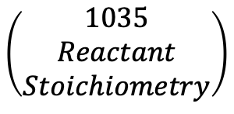
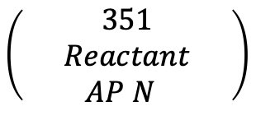
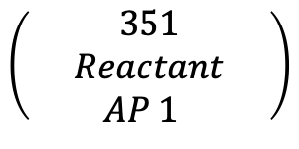
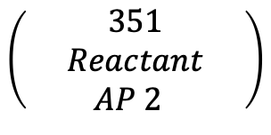
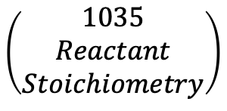
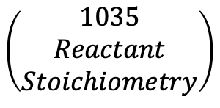
$$\left(\begin{aligned}1035 \\ Reactant \\ Stoichiometry\end{aligned}\right)$$
$$\left(\begin{aligned}351 \\ Reactant \\ AP 1 \end{aligned}\right)$$
$$\left(\begin{aligned}1035 \\ Reactant \\ Stoichiometry\end{aligned}\right)$$
$$\left(\begin{aligned}351 \\ Reactant \\ AP 2 \end{aligned}\right)$$
$$\left(\begin{aligned}1035 \\ Reactant \\ Stoichiometry\end{aligned}\right)$$
$$\left(\begin{aligned}351 \\ Reactant \\ AP N \end{aligned}\right)$$

Slide 9
Consider connectivity by inferred monopartite graph (via products), # successor
Reaction constraints for 1034
1034 reaction | type | #u-n succ | #b-u succ
J1 | n-u | 1 | 1
J2 | n-u | 1 | 0
J3 | u-n | 0 | 0
J4 | n-u | 0 | 1
J5 | b-u | 1 | 0
J6 | u-n | 0 | 0
J7 | u-n | 0 | 0
Species constraint: reactant reactions by type
1034 species | reaction types where 1034 species is a reactant | Compatible 354 species
BCG | bi-uni, uni-null | I, A
Effector.. | null-uni, uni-null | I, A
Tumor_uni.. | null-uni, bi-uni | A, I, R
Tumor_inf.. | uni-null | I, A, D_IA, D_II, R
Assignments of 351 species to 1034 that are consistent with constraints
1034 | 1 | 2 | 3 | 4
BCG | I | I | A | A
Effector.. | A | A | I | I
Tumor_uni.. | R | R | R | R
Tumor_inf.. | D_IA | D_II | D_IA | D_II
*Reaction names have been changed to save space.

Slide 10
BioModels 27
BioModels 354
v1: M -> Mp
v2: Mp -> Mpp
v3: Mpp -> Mp
v4: Mp -> M
J01: -> IP3; R*CaI
J02: CaI -> CaS
J03: CaS -> CaI
J04: IP3 ->
J05: -> g
J06: g ->
J07: -> CaI
J08: CaI ->
J09: CaI -> CaM
J10: CaM -> CaI
J11: CaS -> CaM
Reaction constraint: reaction type
27 | 354 reactions
v1 | J02, J03, J09, J10, J11
v2 | J02, J03, J09, J10, J11
v3 | J02, J03, J09, J10, J11
v4 | J02, J03, J09, J10, J11
Species constraint: number of reactions in which reactant
27 | 354 reactions
M | CaI, CaS, IP3, g, CaM
Mp | CaI, CaS, IP3, g, CaM
Mpp | CaI
V1-- J03: CaS -> CaI
v2 – J09: CaI -> CaM
v3 -- J10: CaM -> CaI
v4 -- J02: CaI -> CaS
The reaction names in 354 have been changed to be shorter.

Slide 11
BioModels 27
BioModels 354
v1: M -> Mp
v2: Mp -> Mpp
v3: Mpp -> Mp
v4: Mp -> M
J1 kPLC: -> IP3; R*CaI
J2 JPump: CaI -> CaS
J3 JChannel: CaS -> CaI
J4 kPhosphatase: IP3 ->
J5 inhibition_parameter1: -> g
J6 inhibition_parameter2: g ->
J7 mwbdcd6a40_1ae7_4c86_a99f_1fba0b8beaf7: -> CaI
J8 mw530793e3_76b2_4483_be11_e94364306712: CaI ->
J9 mwfaf5e05a_b642_4ee2_a069_3c2fc783fba4: CaI -> CaM
J10 mw69f19152_7258_45b0_bf9e_b196f19d7e03: CaM -> CaI
J11 ERtoMito: CaS -> CaM
JChannel: CaS -> CaI
mwfaf5e05a_b642_4ee2_a069_3c2fc783fba4: CaI -> CaM
mw69f19152_7258_45b0_bf9e_b196f19d7e03: CaM -> CaI
JPump: CaI -> CaS

Slide 12
BACKUP

Slide 13
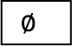
reference_network
target_network
Calculate reference constraints
Calculate target constraints
constraints
constraints
RC1-RC3
SC1-SC4
RC1-RC3
SC1-SC4
Calculate mapping pairs
rm₁,sm₁
rm₂,sm₂
rm_{n},sm_{n}
yes
no
too many
mappings?
$$∅$$
Evaluate mapping pairs
inferred_subnets

Slide 14
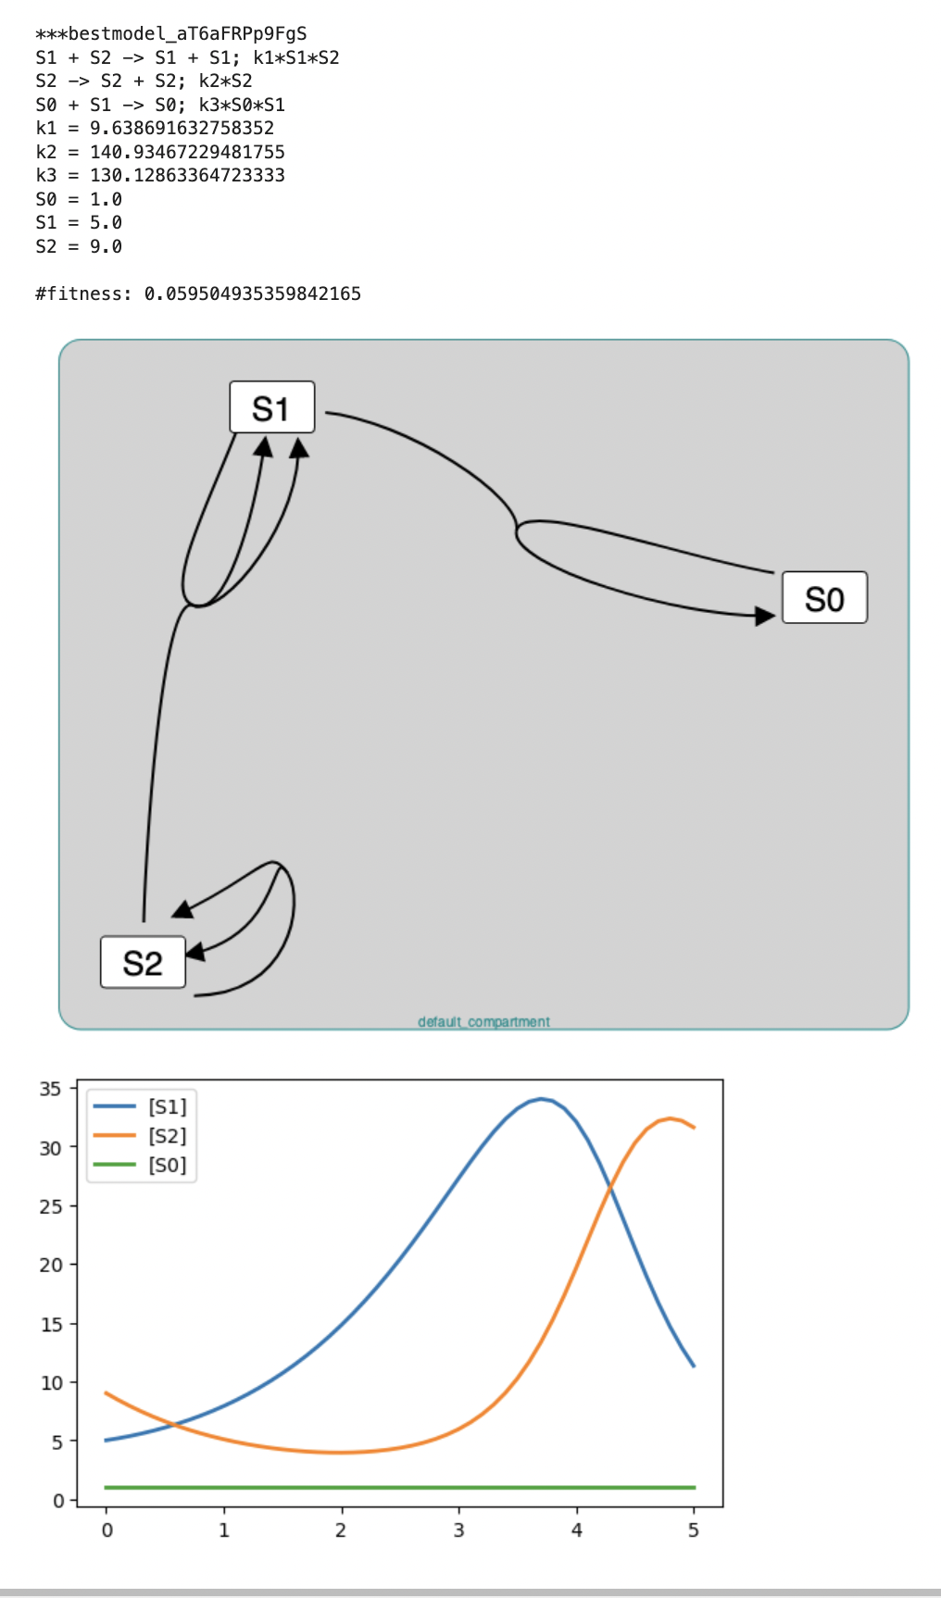
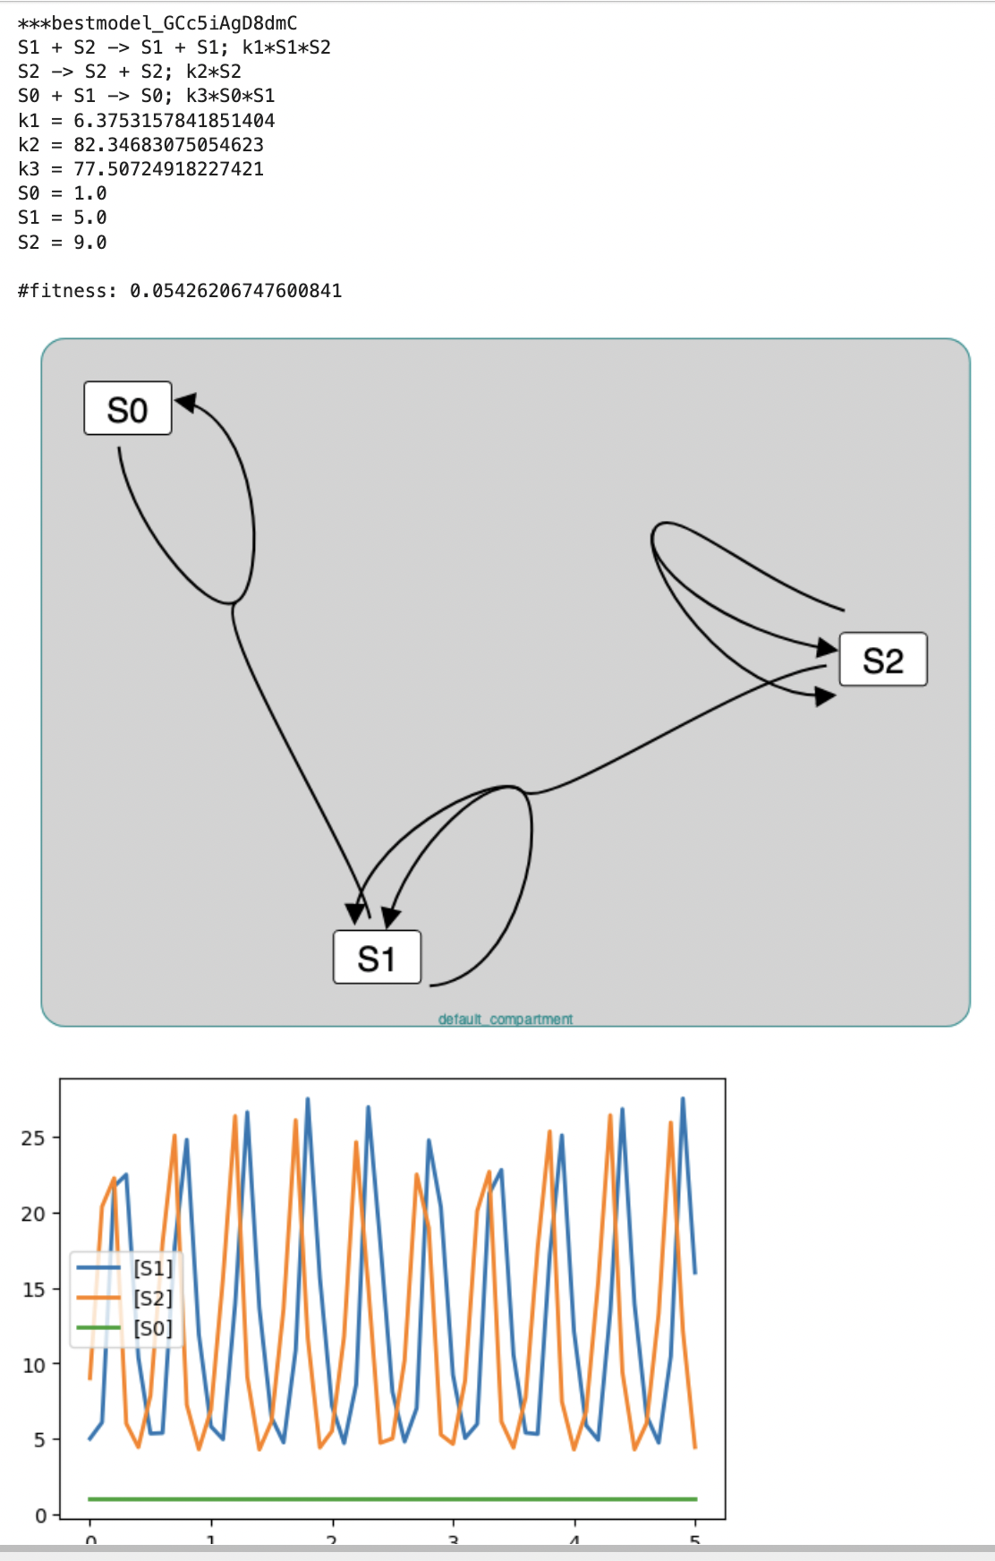
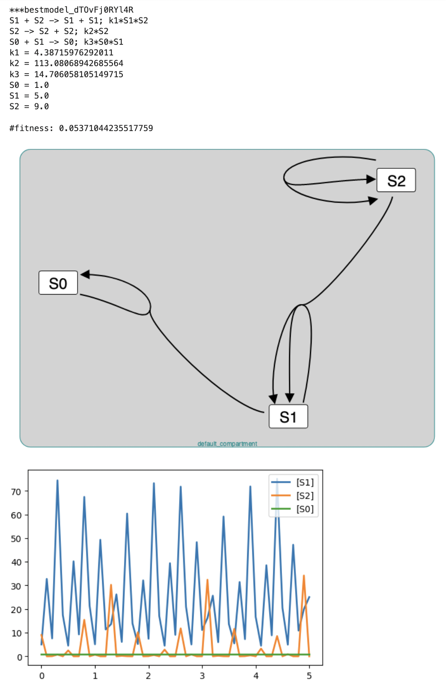
Clustering Problem: Find Structurally Identical Networks In a Large Repository Oscillators_DOE_JUNE_12_B_41373: 66 oscillating networks have the same structure

Slide 15
Approaches to Finding Structural Identical Models in a Large Model Corpus
O(N²), N is number of networks
N is 10,000 to 50,000 in OscillatorDatabase
Naive
for network1 in networks
for network2 in networks
report if network1, network2 are structurally identical
M is 3 to 5 in OscillatorDatabase
Hash
Create a permutably invariant hash for stoichiometry matrices of network in networks
for each unique hash_value
for network1 with hash(network) = hash_value
for network2 with hash(network) = hash_value
report if network1, network2 are structurally identical
O(M²), M is size of largest hash group

Slide 16
Permutably Invariant Hash (piHash) of a Matrix
Definition: Hash value does not change with permutations of the rows and columns of the matrix
Observation
Stoichiometry matrices mostly have values of 0, 1, 2, -1, -2
Examples of permutation independent characteristics
Number of 0s in a row (column). Same for 1s, 2s, -1s, -2s.
Number of values that are not integers -2, …, 2
piHash algorithm
Encode the counts of values of each row (column) as an integer
Sort the encoded values
Hash the sorted encoded values

Slide 17
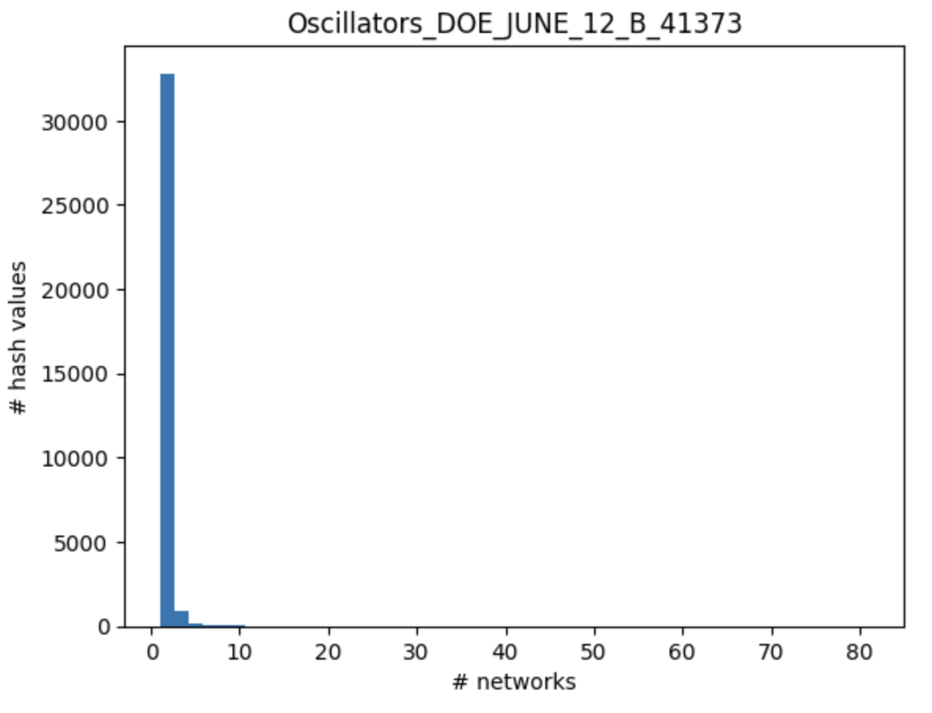
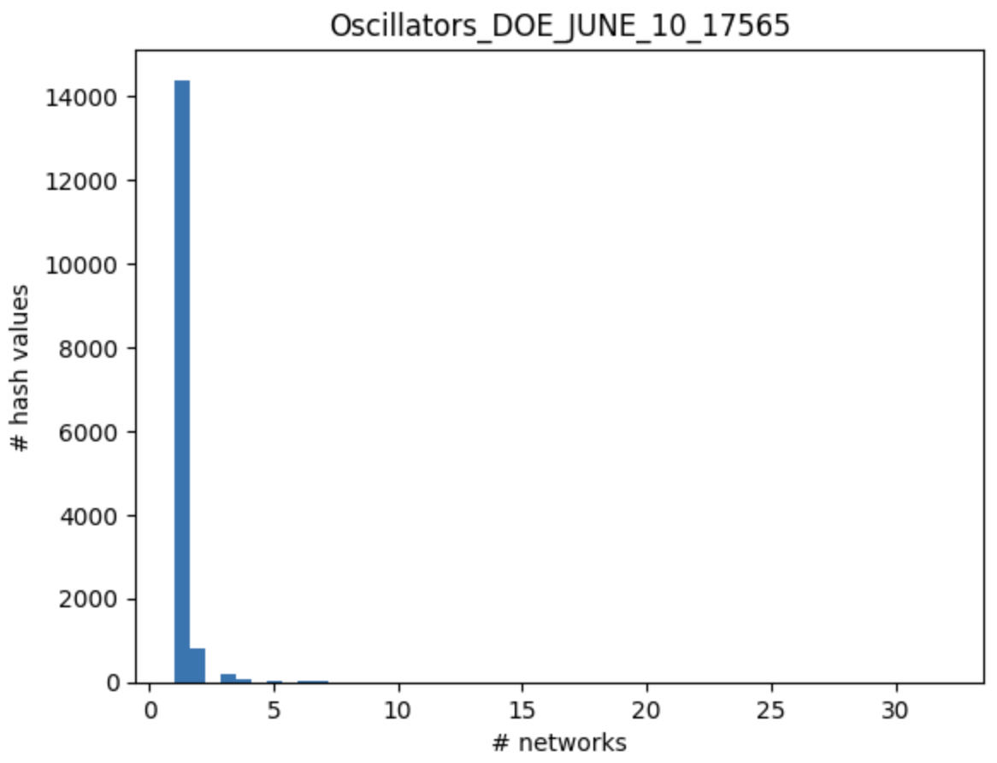
Performance of PIH Hash on Oscillator DB
Complexity is O(25), not O(10**8)
Complexity is O(9), not O(10**8)
M (# networks with the same hash value)
M (# networks with the same hash value)
Both networks have a small percentage of structurally identical models (2% - 5%)

Slide 18
Related Work
nauty – determines if two networks are structurally identical but does not address the clustering problem

Slide 19
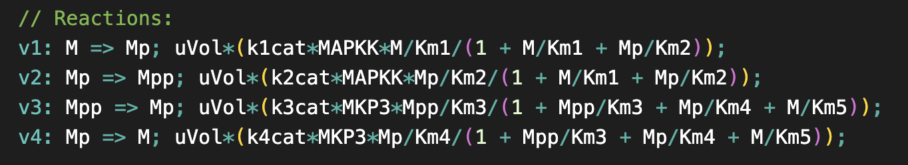
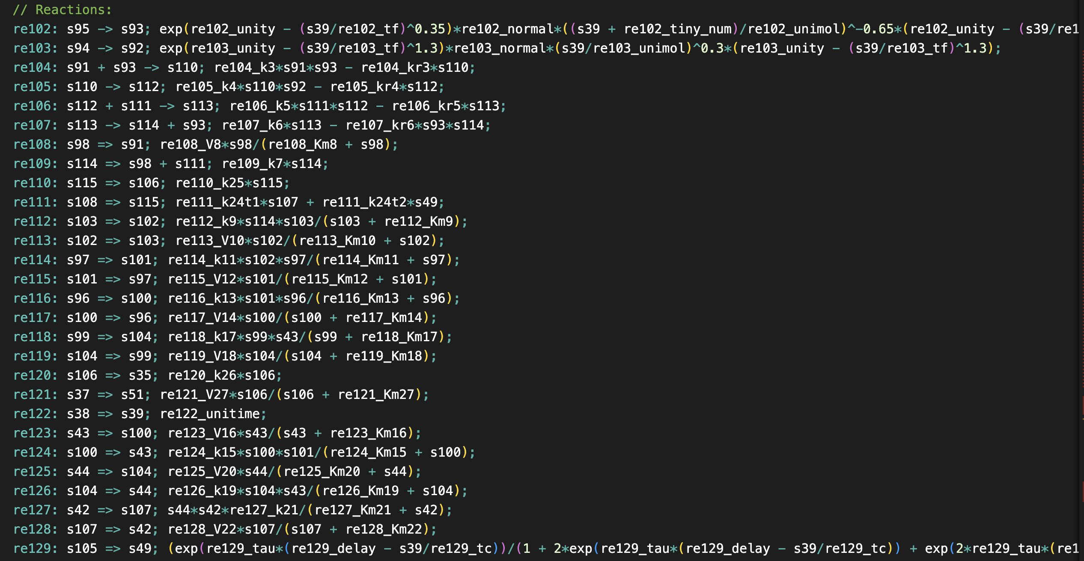
Subnet Problem: Determine if Network A is a Subnet of Network B
BioModels 27
1
2
3
4
Where is 27 inside of 466?
BioModels 466
3
2
1
4

Slide 20
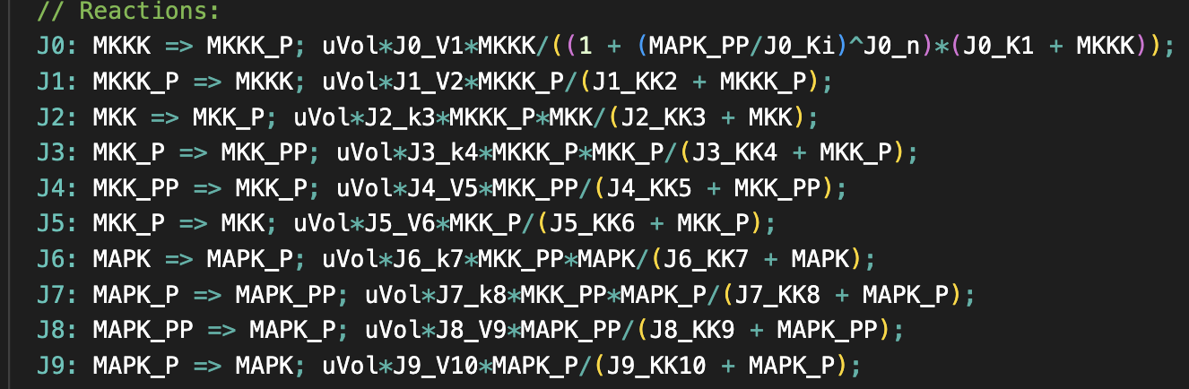
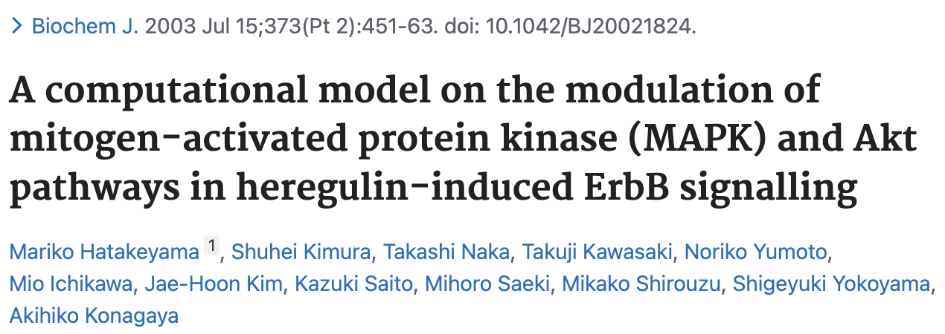
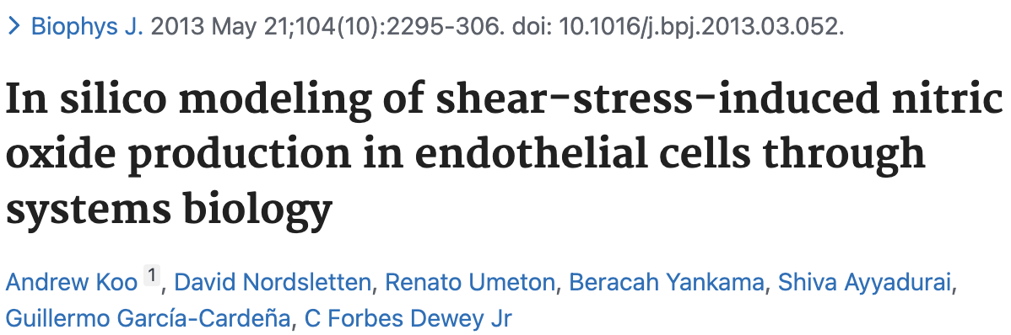

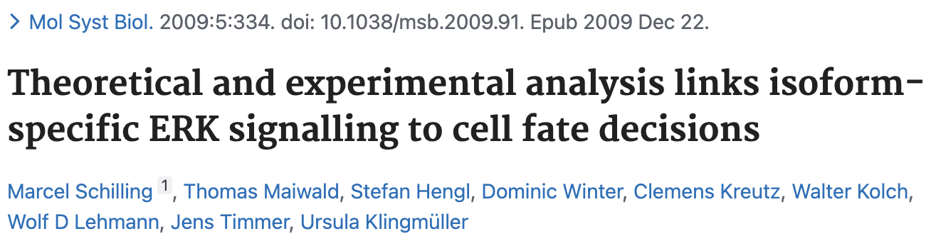
Kholodenko 2000 (10) - Ultrasensitivity and negative feedback bring oscillations in MAPK cascade
What models embed this model?
BioModels 146
BioModels 466
BioModels 468
BioModels 270

Slide 21
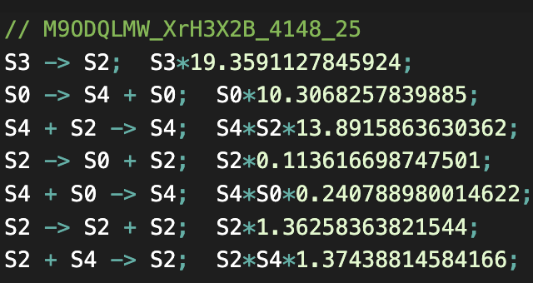
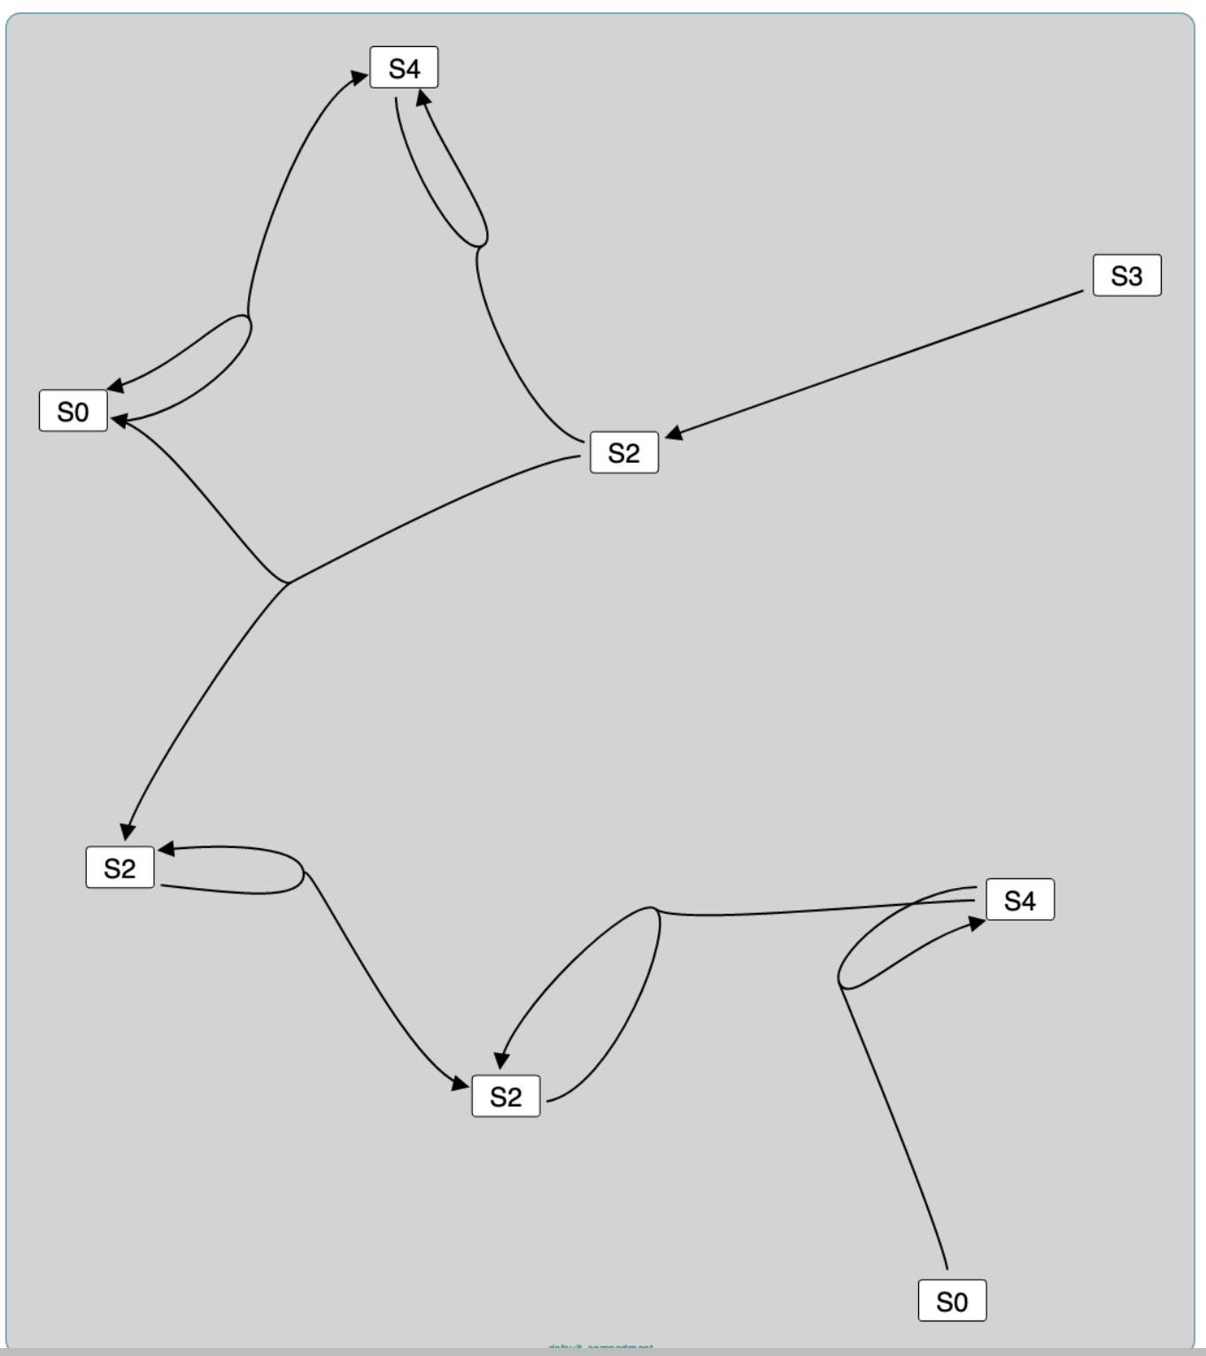
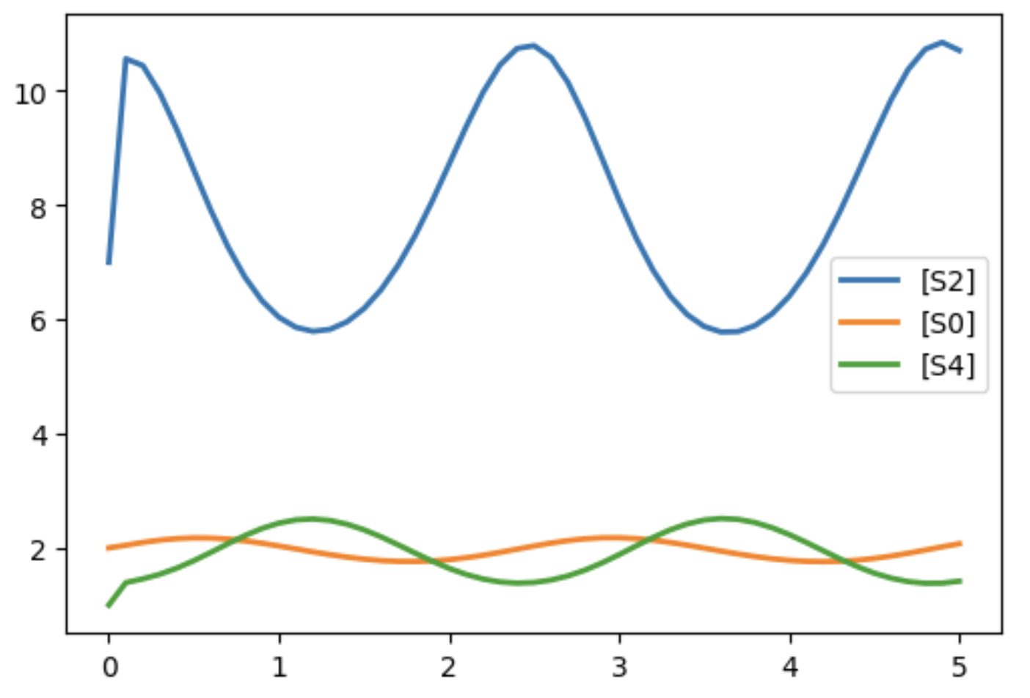
An Oscillator in the Oscillator Database

Slide 22
Subnet Problem: Are there BioModels that contain this oscillator?
FelixGarza2017 (695): Blue light treatment of psoriasis). 35 reactions.
R_13: xFinal_8 -> xFinal_7
R_6: xFinal_3 -> xFinal_3 + xFinal_9
R_15: xFinal_7 + xFinal_9 -> xFinal_9
R_24: xFinal_7 -> xFinal_7 + xFinal_3
R_25: xFinal_3 + xFinal_9 -> xFinal_9
R_14: xFinal_7 -> 2.0 xFinal_7
R_7: xFinal_7 + xFinal_9 -> xFinal_7
Carbo2013 (480): Muscosal immune response during H.pylori infection. 56 reactions.
reaction_16: s1 -> s6
reaction_30: s16 -> s16 + s13
reaction_19: s6 + s13 -> s13
reaction_33: s6 -> s6 + s16
reaction_12: s16 + s13 -> s13
reaction_3: s6 -> 2.0 s6
reaction_39: s6 + s13 -> s6
M90DQLMW_XrH3X2B_4148_25
ArnoldFarquhar2011:(872) RubisCO and the Carbon Cycle. 17 reactions.
re9: s12 -> s13
re5: s2 -> s2 + s4
re14: s13 + s4 -> s4
re1: s13 -> s13 + s2
re3: s2 + s4 -> s4
re24: s13 -> 2.0 s13
re7: s13 + s4 -> s13

Slide 23
Why Find Model Sub-Networks?
Query for models containing structures of interest (e.g., double phosphorylation cycles) to:
Find related work
Select rate laws
Annotate species, reactions
Evaluate the statistical significance of a subnet by
Generating representative random networks
Find if the subnet is present in the random network
Understand higher level structures of chemical networks

Slide 24
Related Work
Running example: R: A + B -> C + D
Related Work
Issue
nauty: Finds identical graphs
Not subgraphs.
Alon 2000: Feedforward loop subnets
Customized search for small subnets in the species graph.
glasgow subgraph solver
Finds subgraphs of source-destination pair graphs (not hypergraphs).
A
(1)
(2)
Doesn’t use hypergraphs so
A -> C is a subgraph
C
R
B
D
(1a)
(2a)
A
C
Finding subgraphs of hypergraphs.
(1)
R
(2)
Some literature. No packages.
No consideration of characteristics of CRNs.
B
D
Conclusion: Finding subnets is a specialized kind of graph analysis.

Slide 25
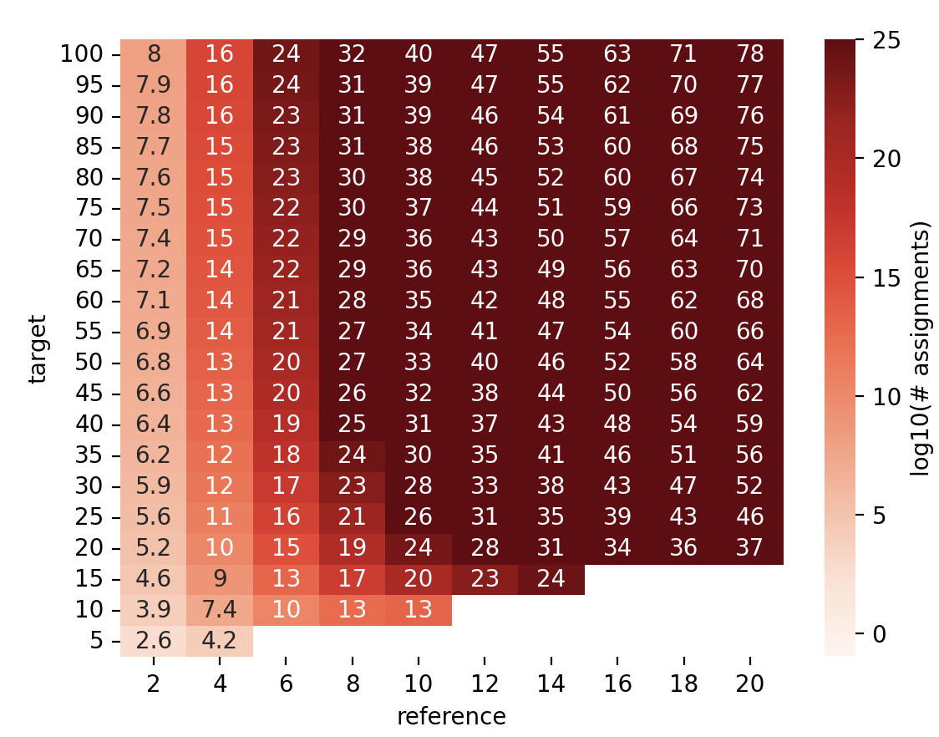
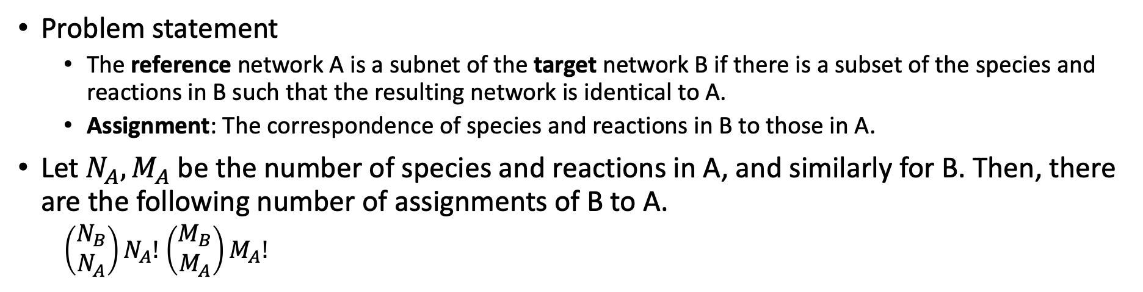
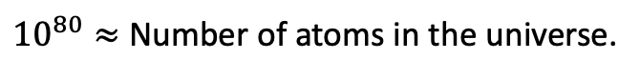
Finding Subnets
Problem statement
The reference network A is a subnet of the target network B if there is a subset of the species and reactions in B such that the resulting network is identical to A.
Assignment: The correspondence of species and reactions in B to those in A.
Let $N_{A}, M_{A}$ be the number of species and reactions in A, and similarly for B. Then, there are the following number of assignments of B to A.
$\left(\begin{matrix}N_{B} \\ N_{A}\end{matrix}\right)N_{A}!$ $\left(\begin{matrix}M_{B} \\ M_{A}\end{matrix}\right)M_{A}!$
$10^{80}≈$ Number of atoms in the universe.
(number species = number reactions)
Notes:
Range of values evaluated are appropriate for the size of models in BioModels.

Slide 26
Strategy
Construct easy-to-calculate constraints for reference networks that reduce the number of assignments.
Increase the speed of assessing constraints by parallelization.

Slide 27
Constraints On Assignments for Chemical Reaction Networks
Reaction constraints
Type of reaction (e.g., uni-uni, uni-bi, bi-uni)
Type of destination reactions (in inferred reaction monopartite graph)
Autocatalysis reaction
Species constraints
Occurrences of species in each type of reaction as a reactant
Occurrences of species in each type of reaction as a product
Autocatalyzed species
Constraints are represented as numpy arrays and their analysis is vectorized.
Benchmark evaluation
Generate networks based on the distribution of reaction types in BioModels

Slide 28
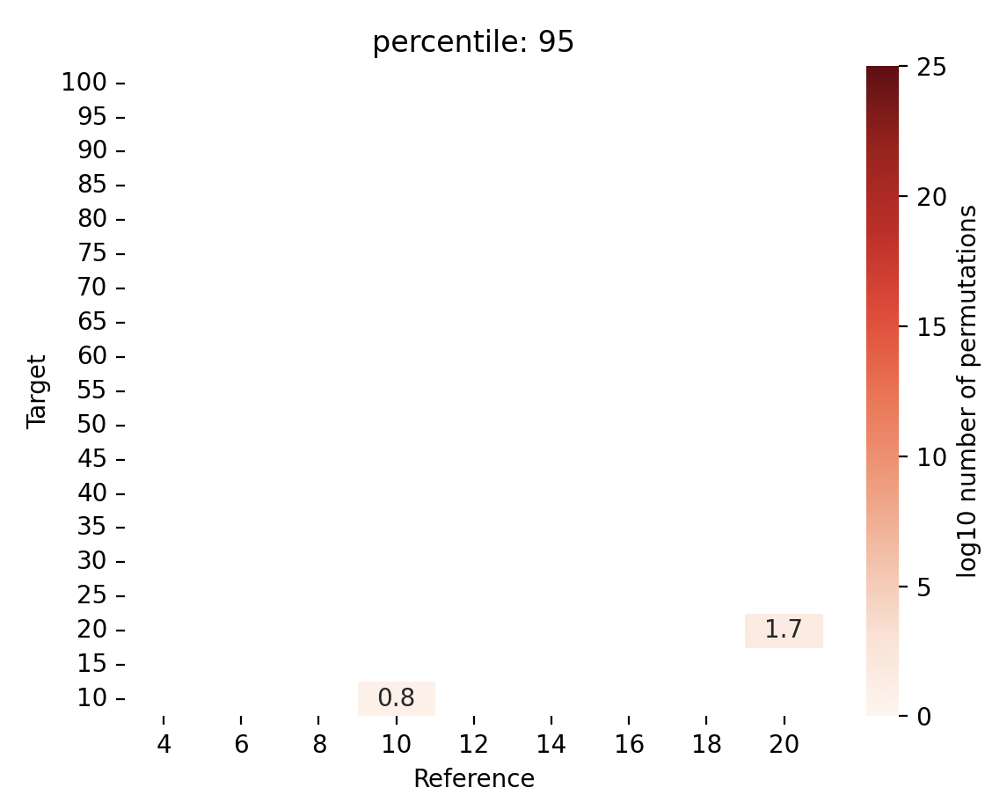
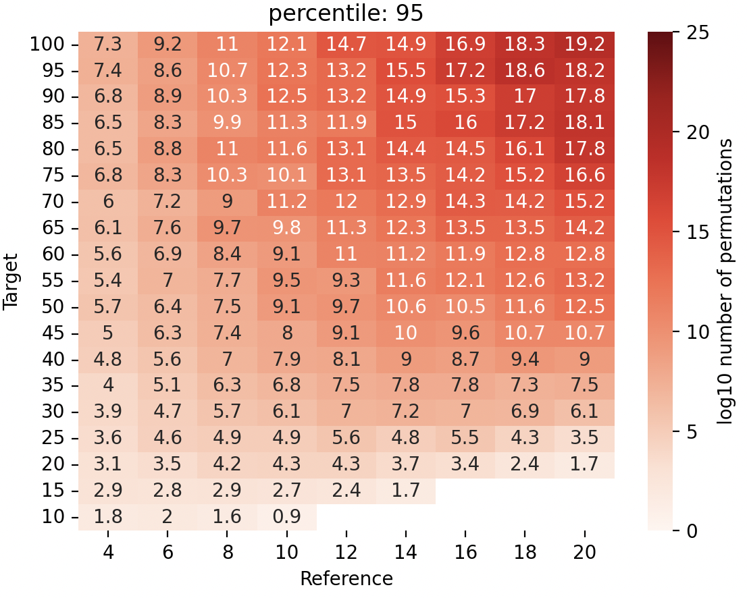
Constraints reduce the number of assignments
No Constraints
Reference Network Absent
Reference Network Present
95 percentile w/Constraints
95 percentile w/Constraints

Slide 29
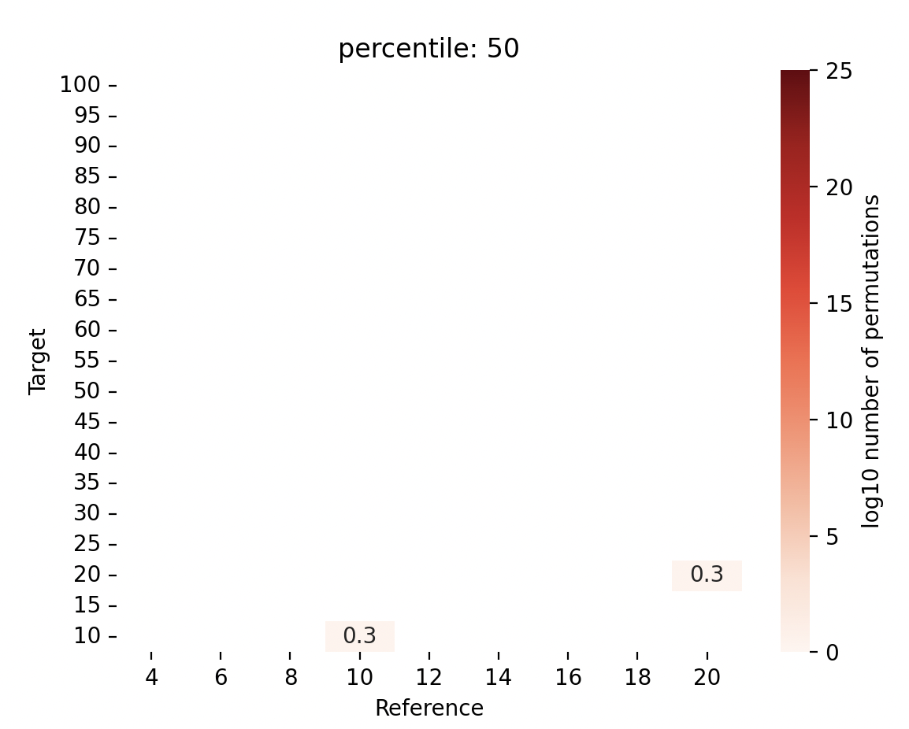
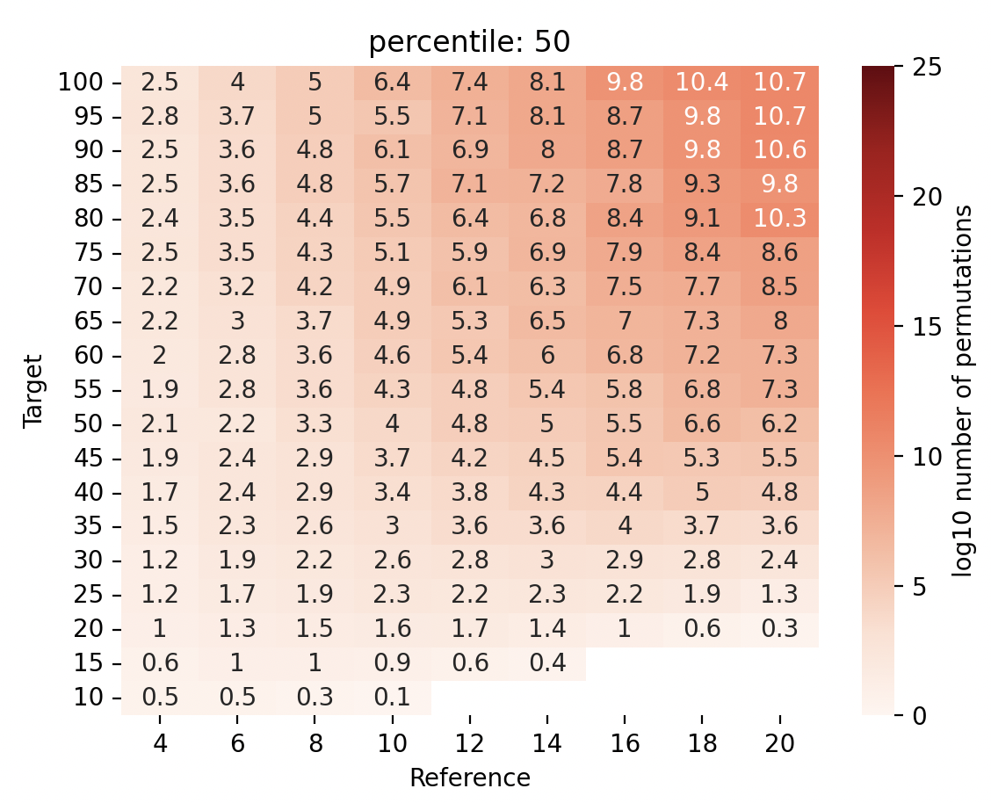
Constraints reduce the number of assignments to consider
Reference Present
95 percentile w/Constraints
No Constraints
Reference Absent
Reference Present
50 percentile w/Constraints
50 percentile w/Constraints

Slide 30
Parallelism
Vectorization
Evaluate many assignments simultaneously by proper memory layouts
Process parallelization
Use python multiprocessing to run many vectorizing processes at once.
Results
No parallelism: ~100K Assignment/s
Vector parallelism: ~1M Assignment /s
Vector + 10 process parallelism: ~10 M/s
~1 day to evaluate 10¹² assignments with 20 M1 mac cores

Slide 31
Contributions
piHash algorithm for scalable discovery of structurally identical models.
Scalable constraint-based approach to finding sub-networks.
Open-source python package that provides (1) and (2).
Application to Oscillator Database and BioModels.

Slide 32
Next Steps
Review with Anatasia
Create a package
More detailed analysis of BioModels

Slide 33
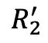
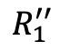
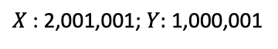
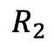
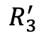
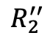
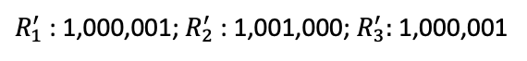
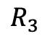
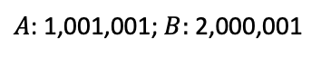
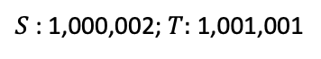
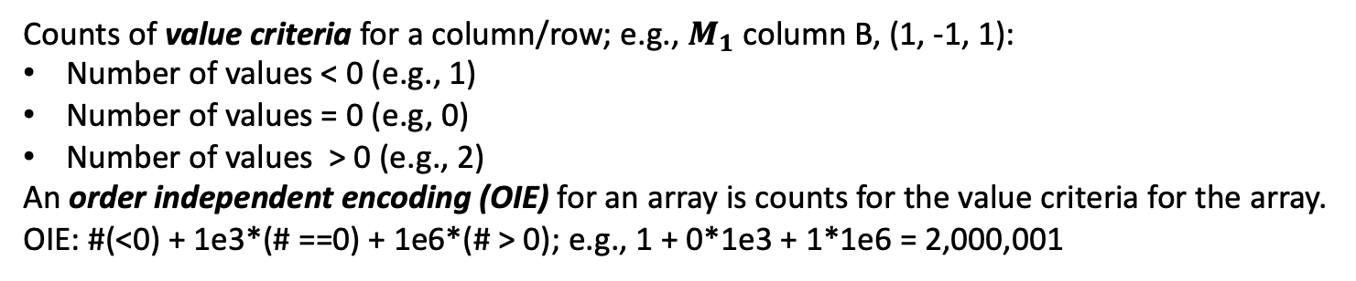
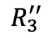
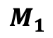






Order Independent Encoding (OIE) of Arrays
Counts of value criteria for a column/row; e.g., $M_{1}$column B, (1, -1, 1):
Number of values < 0 (e.g., 1)
Number of values = 0 (e.g, 0)
Number of values > 0 (e.g., 2)
An order independent encoding (OIE) for an array is counts for the value criteria for the array.
OIE: #(<0) + 1e3*(# ==0) + 1e6*(# > 0); e.g., 1 + 0*1e3 + 1*1e6 = 2,000,001
$$M_{1}$$
 | A | B
 | -1 | 1
 | 1 | -1
 | 0 | 1
$$M_{2}$$
 | X | Y
 | 1 | -1
 | 1 | 0
 | -1 | 1
$$M_{3}$$
 | S | T
 | 1 | -1
 | -1 | 0
 | -1 | 1
$$R_{1}$$
$$R_{1}^{′}$$
$$R_{1}^{′′}$$
$$R_{2}$$
$$R_{2}^{′}$$
$$R_{2}^{′′}$$
$$R_{3}$$
$$R_{3}^{′}$$
$$R_{3}^{′′}$$
$R_{1}$: 1,000,001; $R_{2}:$1,000,001; $R_{3}:$1,001,000
$R_{1}^{′}$: 1,000,001; $R_{2}^{′}$: 1,001,000; $R_{3}^{′}:$1,000,001
$R_{1}^{′′}$: 1,000,001; $R_{2}^{′′}$1,001; $R_{3}^{′′}:$1,000,001
$A$: 1,001,001; $B:$2,000,001
$X$: 2,001,001; $Y:$1,000,001
$S$: 1,000,002; $T:$1,001,001

Slide 34
















DSIRN: Detecting Structurally Identical Reaction Networks: 2
1,001,001
2,000,001
1,001,001
2,000,001
$$M_{1}$$
 | A | B
 | -1 | 1
 | 1 | -1
 | 0 | 1
$$M_{2}$$
 | Y | X
 | -1 | 1
 | 1 | -1
 | 0 | 1
1,000,001
$$R_{1}$$
?
1,000,001
$$R_{1}^{′}$$
1,000,001
$$R_{2}$$
$$=$$
1,000,001
$$R_{3}^{′}$$
1,001,000
$$R_{3}$$
1,001,000
$$R_{2}^{′}$$
1,001,001
2,000,001
1,001,001
2,000,001
$$M_{1}$$
 | A | B
 | -1 | 1
 | 1 | -1
 | 0 | 1
$$M_{2}$$
 | Y | X
 | -1 | 1
 | 1 | -1
 | 0 | 1
1,000,001
$$R_{1}$$
?
1,000,001
$$R_{1}^{′}$$
1,000,001
$$R_{2}$$
$$=$$
1,000,001
$$R_{3}^{′}$$
1,001,000
$$R_{3}$$
1,001,000
$$R_{2}^{′}$$

Slide 35
Bipartite Hypergraphs Are Required to find Subnets
Consider the network with one reaction: R: A + B -> C + D
The bipartite hypergraph representation is depicted below. There are 5 nodes: 4 species nodes and 1 reaction node. There are two hyperarcs, (1) and (2).
A
C
(1)
R
(2)
B
D
The hyperarcs are required in order to have the correct semantics for finding a subset of the model. Below is a graph without hyperarcs. That is, the arc (1) represents (A, R), etc. In this case, the reaction A->C is a subgraph, which is not a correct interpretation of a subset of a reaction network.
(1)
(2)
A
C
R
B
D
(1a)
(2a)

Slide 36
Reference network
Construct constraints for reference network
Construct compatibility vector
Prune compatibility vector
Target network
Construct constraints for target network
Expand pruned compatibility vector into assignments
Calculate assignment pairs

Slide 37


Computational Complexity of Naïve Algorithm to Detect Weak Structural Identical
Naïve Algorithm
def isPIdentical(M1:matrix, M2:matrix):
for rp in reaction_permutations
for sp in species_permutations
if M1[rp, sp] == M2;
return True
return False
--age of universe
--millennium
--century
--year
--day
Computational complexity: $O(N!M!)$
N is number of reactions
M is number of species
--hour
--second
Long compute times on modest size networks:
5 species, 10 reactions
1.5 hrs (Mac M1, 12 usec/comparison)
log₁₀ (hour) on mac M1

